Slide 1

OBJECT ORIENTED PROGRAMMING
PROJECT PRESENTATION
GROUP MEMBERS:
AHMAD WALEED AKHTAR
M.ARHAM
HADIA AHMAD

Slide 2
Problem statement:
You are recruited by a garage owner to create a garage management system(GMS) for the garage. To prevent information jamming, This (GMS ) stores information about client cars and the necessary servicing that needs to be done. This system will need to keep track of customer information, vehicle details, and necessary faults for repairs.

Slide 3
SOLUTION APPROACH:
1.Identifying 4 main points of garage system:
Vehicle (brought in by customer)
Customer
Employees working in the garage
Admin to overview all this.
2. Code implementation:
1. Making base class of general and common attributes to be used.
Vehicle
Person

Slide 4
2. Making subclasses having there own attributes along with common attributes
Person:
CUSTOMER
ADDRESS
PERSON
EMPLOYEE
Vehicle
Bus
Vehicle
Hatchback
Sports Car
Sedan

Slide 5
3.Working of subclasses
1.Customer
Adding customer
Removing customer
Editing customer info
Searching customer
2.Employee
Adding employee
Removing employee
Editing employee info
Searching employee
3.Cars (particular type)
Having their own particular main specified functions
Inheriting vehicles general function regarding vehicle specification

Slide 6
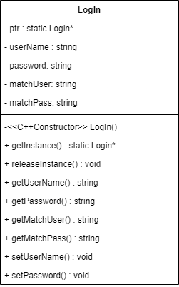
4.Structure of Program
Log In
The program is designed to be used by admin or manager of the garage. User is required to enter a username and password at the start of the program. If the username and password is correct user is able to access other feature of the program else the program ends.
For this purpose we created a singleton class named “logIn”. It’s UML diagram is given below,

Slide 7
4.Structure of Program
Customer & Employee
To store and manage customer and employee data we created a base class named “Person”.
Object of another class named “Address” is present in person class. Then we used person class to make two derived classes named “Customer” and “Employee” to store and manage customer and employee’s data respectively.
Address: This class is used to store address of a person.
Person: This class contains all the necessary and common info of a person like their name and contact number etc.
Customer: This class inherits base qualities of a person from Person class. Additionally it contains information about customer vehicle etc.
Employee: This class inherits base qualities of a person from Person class. Additionally it contains information about employee’s monthly salary etc.
UML of these classes is given in next slide.

Slide 8
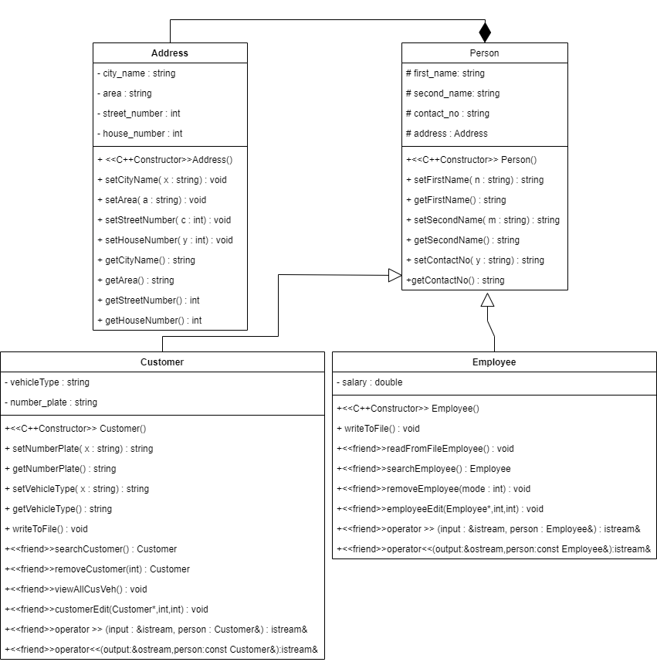

Slide 9
4.Structure of Program
Vehicle & Subclasses
To store and manage customer’s vehicle data we created a base class named “Vehicle”. This call was then inherited by 4 other classes named:
Sedan
SportsCar
HatchBack
Bus
CusVeh
To create relation between customer and his vehicle we created an other class named “CusVeh”. This is an template class in which customer and his respective vehicle class is aggregated.
UML of these classes is given in next slide.

Slide 10
